Slide 1
Self- Introduction Video Profile
1.Basic structure.
2. Do’s and Don’ts
3. Personal Grooming-Personal Distance-Body
Language
4. Content Preparation
5. Practice Session
6. Students Presentations and Evaluator’s Feedback
7. Making Etiquette on Video Resume/Profile

Slide 2
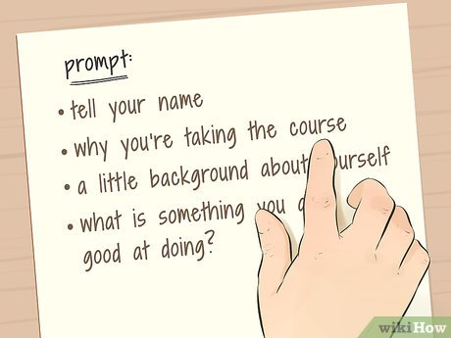

Basic structure
Past
Present
Future

Slide 3
Do’s
1.Use a strong voice, clear diction and correct grammar.
2.Make sure your personal appearance is approvable ( correct in behavior) and proper, and you dress
appropriately.
3.Establish eye contact with the audience but do not stare.
4. Do display a sense of wit as and when possible.
5. Do exhibit a mixture of self-confidence, grace and balanced gestures/ emotions.
6. Do make concrete goals in planning for your career.
7. Do support your answers with examples, wherever possible.
8. Do present yourself as a multi rounded personality with ability to learn from both academic and
extracurricular activities.
Don’ts
Don't be arrogant, overaggressive, or vain.
Don't show a lack of attention or energy.
Don't make excuses
Don't be uncertain and indecisive in your thoughts.
Don’t show your nervousness

Slide 4
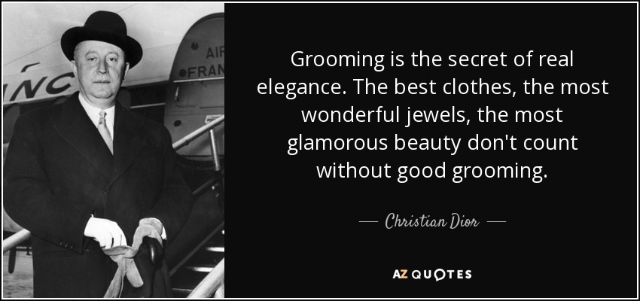
Personal Grooming – Personal Distance – Body Language
Personal grooming is important for a positive self-image and every effort should be made to encourage and assist the resident to maintain a pleasing and attractive appearance.
FIRST IMPRESSION
HOW TO CREATE THE IMPACT FOR THAT FIRST IMPRESSION When you meet someone for the first time they will make their minds up about you based upon:
Your Appearance
Body Language
Smile
Eye Contact
Stance And Posture
How You Sound
What You Have Got To Say

Slide 5
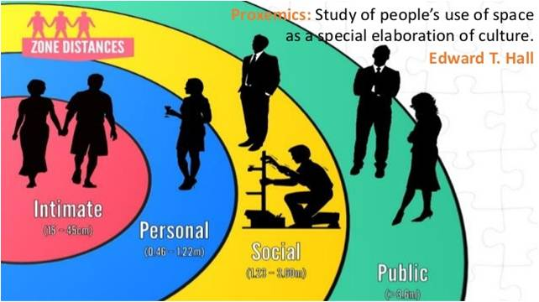
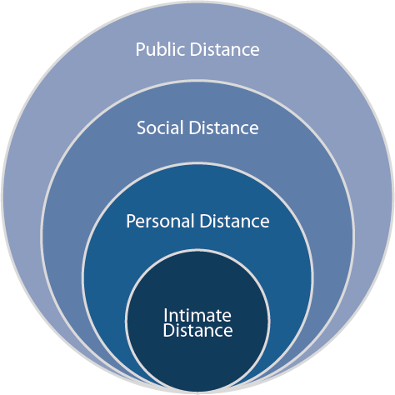
Personal Distance
Anthropologist Edward T. Hall described four levels of social distance that occur in different situations:
1.Intimate distance - 6 to 18 inches (15 to 45 cm)
2.Personal or friend distance - 1.5 to 4 feet (45cm to 1.2 meters)
3.Social distance - 4 to 12 feet (1.2 meters to 3.6 meters)
4.Public or audience distance - 12 to 25 feet (3.6 meters to 7.5 meters)

Slide 6
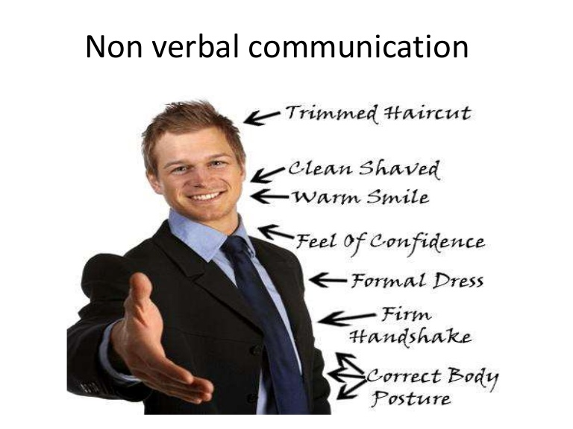
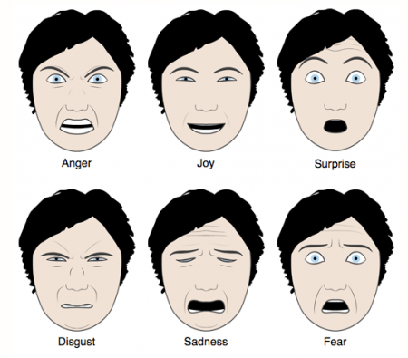
Body Language
refers to the nonverbal signals that we use to communicate.
It has been suggested that body language may account for between 60 to 65% of all communication.
Body Language includes
1. Facial Expressions
2. Body movement and posture.
3. Gestures.
4. Eye contact.
5. Voice.
6. Space.
﻿

Slide 7

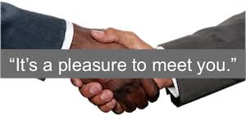
Content Preparation
1. Greetings
2. Acknowledgement
4. Name
5. Where are you from
6. Education
7. Achievements
8. Differentiation
9. Hobbies
10. Personality
11. Skills
12. Unique Closure

Slide 8
Students Presentations and Evaluator’s Feedback

Slide 9
Making Etiquette
Tips for Creating an Excellent Self-Introduction Video
In the crowded world of English teaching applicants, your resume, photo, degree, and any other certificates aren’t enough to help you stand out.
But an excellent self-recorded introduction video will! It can prove your capabilities to the audience by hearing your English skills as well as your voice.
It creates personal connections with the people and builds rapport with your team members.
Remember that it’s a short video of only 1-3 minutes long. Be concise and to the point!

Slide 10

Relevant Information
State your name clearly
Grab the attention
Personify the Camera
Make it about your audience
Promote your content
Planning
Write video script in advance
Rehearse
Make sure you are fully prepared for Recording
Record several trial versions

Slide 11
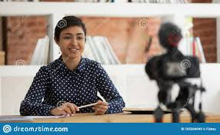
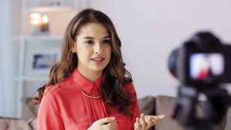
Recording
Speak Clearly not too fast
Show your energy and confidence
Look Presentable
Frame the video well
Set up a well light Environment
Record in a Quiet Place

Slide 12
Record
1.Do’s and Don'ts of Self- Introduction
2. How to make Self- Introduction more effective.( oral and making video )
3. Sample formal Self- Introduction

